Slide 1

Retail Consumer Behavior & Loyalty Analytics
A comprehensive data-driven study of customer segments, purchase behavior, and strategic growth opportunities
Presented by –Bhumika and Deepanjali

Slide 2




Problem Statement
A leading omnichannel retail company possesses extensive transaction data but lacks a structured analytical framework to convert it into business decisions. Key gaps include inability to identify valuable customer segments, unclear loyalty drivers, and no data-backed promotional strategy.
Who are our most valuable customers?
What drives loyalty vs. one-time purchases?
Q4
Do discounts build loyalty or just attract bargain hunters ?
Which products and seasons drive the most revenue?

Slide 3
Project Methodology
02
Python Cleaning
Kaggle Notebook
Removed
duplicates & nulls
Feature engineering: +8 columns
Standardised text columns
03
MySQL Analysis
MySQL Workbench
Exported insights to CSV
25 analytical queries
10 business dimensions
04
Power BI
3-Page Dashboard
Interactive slicers
Navigation buttons
KPI cards + 15+ visuals
05
Insights & Report
This Presentation
5 key findings
5 strategic
recommendations
Executive summary
01
Raw Data
Dataset
18 original columns
Consumer shopping data
3,900 transactions

Slide 4





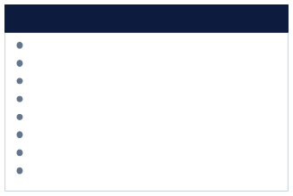
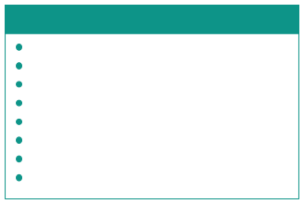
Dataset Overview & Feature Engineering
26
Columns After Engineering
3,900
Total Transactions
$233K
Total Revenue
$59.76
Avg Order Value
Original Columns (18)
Engineered Features (+8)
Customer ID · Age · Gender
Item Purchased · Category
Purchase Amount (USD)
Location · Size · Color · Season
Review Rating · Subscription Status Shipping Type · Discount Applied
Promo Code Used · Previous Purchases Payment Method · Frequency of Purchases
Age Group Repeat Buyer
Under 18 , 18–25 , 26–35 , 36–50 , 50+ Yes/No flag from Previous Purchases New / Occasional / Regular / Loyal
Low / Medium / High (quantile-based) Combined Discount + Promo flag Numeric visits per year
Purchase Freq. Segment
Purchase Value Segment
Any Discount
Annual Purchase Freq.
Loyalty Score
Est. Historical Spend
Frequency + purchase history composite
Purchase Amt × Previous Purchases

Slide 5



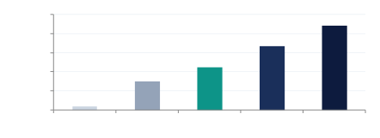
Finding 01 · Customer Segments
Demographics
100000 80000 60000 40000 20000 0
88,000
66,500
50+
highest total revenue
44,500
30,200
4,100
Under 18
18–25
26–35
36–50
50+
Male customers aged 50+ generate the highest revenue AND have the highest loyalty score (49.7)
Younger customers (18–25) purchase frequently but spend significantly less per transaction
Payment preferences correlate with age

Slide 6

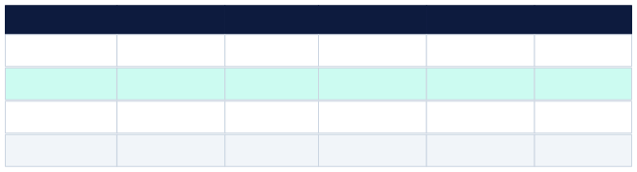
Finding 02 · The Footwear Paradox
Product Strategy
More customers ≠ More value per customer
Total Revenue
Category
Total Customers
Avg Order Value
Avg Loyalty Score
Verdict
Clothing
1,737
$104K
$59.9
45.1
High Volume
Foot wear
974
$59K
$60.5
45.8
Higher Value
Accessories
852
$50K
$58.6
44.9
Stable
Outerwear
337
$20K
$59.3
45.0
Niche
Strategic Implication
The company is over investing in Clothing acquisition while under investing in Footwear the category with the most loyal and individually valuable customers. A targeted Footwear loyalty program would yield higher ROI per customer acquired.

Slide 7




Finding 03 · Discounts Are Not Building Loyalty
Critical Finding
42.1
Discount Users
48.3
Non-Discount Users
14.7% lower loyalty among discount users
Bargain Hunter Pattern
Promo Code vs. Discount
Under-18 Discount Trap
Older male customers (50+) are the most profitable discount users with high loyalty (49.7) but this is despite discounts, not because of them.
Customers using only promo codes show slightly better repeat rates than direct discount recipients, suggesting code-based rewards work marginally better.
The youngest segment uses discounts frequently but contributes the least revenue and lowest loyalty scores ,a clear inefficiency in the current promotional mix.

Slide 8





Finding 04 · Subscription Model Needs Redesign
Retention
Subscribed
Non-Sub
What This Means
Subscribers show 25% higher loyaltyscoresbut generate
almost identical lifetime value. The subscription program is creating engagement without converting it into incremental spend a classic loyalty revenue disconnect.
Avg Loyalty Score
52.85
42.37
+25% higher
Recommended Fix
Add spend-based milestones (e.g. spend $300 - free shipping next month)
Avg Purchase Amount
$59.8
$59.7
≈ Same
Introduce exclusive early access to new collections for subscribe
Est. Lifetime Value
Track & surface subscriber-specific savings in-app to reinforce value
$1,485
$1,421
Minimal diff.

Slide 9



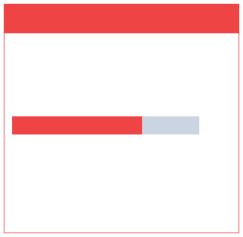
Finding 05 · Hidden Revenue Opportunities
Opportunity A : Male Gifting Behavior
Opportunity B : Shirt Satisfaction Risk
Men are buying Dresses
"Dress" ranks #3 in revenue for male customers , a category they would not typically buy for themselves. This is a clear signal of gifting behavior.
High revenue, lowest satisfaction
"Shirt" is the 2nd highest revenue item for women but holds the lowest satisfaction score across all items at 3.48 / 5.0. This is a retention time bomb.
Recommendation:
Launch a "Gift for Her" section specifically surfaced to male users. Add gift wrapping, personalized notes, and size guides. Men spend more on jewellery than female customers ,this
gifting intent is already proven.
3.48 / 5.0 (Lowest in dataset)
Recommendation:
Conduct a targeted customer feedback campaign on Shirt quality before next season. Investigate sizing accuracy, fabric quality, and return rates. Sunglasses have the highest satisfaction for women(3.92). Study what that product does right and apply it to Shirts.

Slide 10
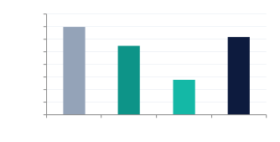
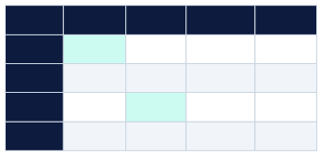
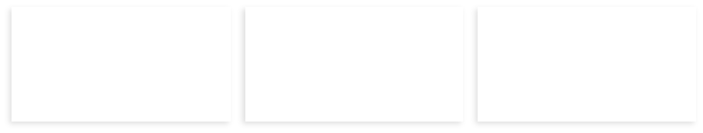



Finding 06 · Seasonal & Geographic Insights
Revenue by Season
Season ×Category Performance
61000 60000 59000 58000 57000 56000 55000 54000 53000
60,000
Clothing
Footwear
Accessories
O ut erwear
59,200
58,500
Winter
High
Low
S ta ble
Medium
55,800
Spring
High
Medium
S ta ble
Low
Summer
Medium
High
S ta ble
Low
Fall
High
Medium
S ta ble
Medium
Fall
Spring
Summer
Wi nter
Montana
Illinois
Alabama
1 Revenue
Top State
Highest Loyalty
Best Retention
Highest Repeat Orders
Most Loyal Buyers

Slide 11








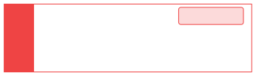
Strategic Recommendations
High Impact
Medium Impact
Target the 50+ Male Segment
This demographic has the highest loyalty, frequency, and spend. Concentrat eat least 30%of paid acquisition budge there.Build look-alike audiences based on this profile.
Redesign Subscription with Spend
Milestones
Add spend-triggered rewards (e.g. spend $300 - free shipping nextquarter). Convertthe25%loyaltyadvantagesubscribers already have into actual incremental revenue.
01
04
High Impact
Urgent
Investigate Shirt Product Quality
Immediately
Second highest revenue item for women with the lowest satisfaction score (3.48) is a retention risk. Audit sizing, returns, and fabric quality before the next season launch.
Launch a Footwear Loyalty Program
Footwear customers are individually more valuable than Clothing customers. A category-specific program (double points on footwear) will retain high-LTV customers at lower cost.
02
05
High Impact
Replace Flat Discounts with Points
System
Discount users show 14.7% lower loyalty scores. A points-based system rewards repeat behavior rather than one-time bargain seeking ,better ROI on promotional spend.
03

Slide 12

THANKYOU

